Slide 1

Annual General Meeting
November 28, 2024
We will begin shortly

Slide 2

Welcome to CareNow Ontario’s AGM CareNow Ontario is an organization supporting and representing the medical conditions of medical conditions of Myalgic Encephalomyelitis/Chronic Fatigue Syndrome, Fibromyalgia and Environmental Sensitivities/Multiple Chemical Sensitivity. Fibromyalgia and
Notes:
I’m Keith Deviney vice chair of CareNow Ontario and I will be chairing this meeting
On behalf of CareNow Ontario I welcome everyone to the 2024 AGM
We’ll call the meeting to order. Quorum is 10. We have quorum with xx members attending in person and x proxies for a total of xx voting members.
I’ll now call on Adrianna Tetley, who will assist in moderating this meeting to go over a few housekeeping details.
DENISE: Currently have xx registered voters; xx in person and xx proxies (to verify at the time of the registration….)
Introduces Adrianna as the moderator who will now walk us through some housekeeping for today’s meeting.

Slide 3

Housekeeping
Audio
All attendees are automatically muted when joining Zoom.
We will unmute everyone when it is time to speak.
Getting on the Speakers List:
Raise your hand using the “Reactions Button” and press “raise your hand”
Type in the Chat that you want to speak.
Chat
Open up the chat window to chat with other participants or ask questions
Notes:
Adrianna

Slide 4
Housekeeping
Sharing Video
You can turn your camera on or off with the Start/Stop Video button.
Troubleshooting
If you have issues with your Internet connection, try turning off your video.
Make sure all other programs and applications that use Internet are turned off.
Joining by phone
If your Internet connection is unstable, you can join by phone.
Instructions on how to join by phone are available in your registration confirmation email.
Notes:
Adrianna

Slide 5
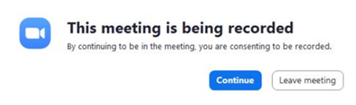
Housekeeping
Recording
This webinar will be recorded for minute taking purposes only.
You will be prompted with the window below, please press CONTINUE to remain in the webinar and feel free to turn your video off.
Notes:
Adrianna

Slide 6
Voting:
For ease of process on zoom, each motion already has a recorded mover and seconder that you will see on the screen.
We will do a roll call vote for each motion. Please note that some people are holding proxies and when they vote they will announce the number of votes including their own. ie. Yes 3 votes. Or Yes 2 No 1
The Chair of the meeting, will not vote, except for their proxies, unless there is a tie.
.
Notes:
Adrianna
Back to Keith

Slide 7
AGM Agenda
cfs
Call to order: Announce Quorum
Approval of Agenda
Advancing Accessibility and Human Rights for people with MCS: R Peris, ASEQ-EHAQ
Approval of Minutes of 2024 AGM
Treasurer’s Report: A. Tetley
Motion to approve financial statements
Motion to appoint auditor
Financial Plan for 2025
Nominations Report Election of Directors: J. Doherty
Update on Government Relations and advocacy work A Tetley
Advocacy Workplan for 2025 A. Tetley
Denise Magi’s Reflections
Tribute To Denise Magi:
Other Business
Adjournment
Notes:
Keith
The first order of business is to approve the Agenda as presented. It was sent out in advance with the Notice of Meeting.
(do not read it – they got it in advance…)
Any questions
Seeing none, lets move to approve the agenda

Slide 8
MOTION: Approve Agenda
Be it resolved that the Agenda now before this meeting, held November 28, 2024 be approved as presented.
Moved by: John Doherty
Seconded by: Laurie Menard
Notes:
Keith presents the motion to approve the agenda.
I’ll call on Adrianna to conduct the vote.

Slide 9
Advancing Accessibility and Human Rights for people living with MCS across Canada
Presentation by: Rohini Peris, Environmental Health Association of Quebec (ASEQ/EHAQ).
Notes:
Keith: We’ll now call on Rohini Peris, President and CEO of Environmental Health Association of Quebec (ASEQ/EHAQ) who will speak about “Advancing Accessibiltiy and Human Rights for people living with MCS across Canada”.
ASEQ/EHAQ just received an award from a leading national disabilities group - the Butterfly Effect Prize of Prix Papillon for the work of the Empowering Community and Removal of Barriers (ECRoB) project. Congratulations to Rohini and her team.
Over to Rohini
KEITH – Rohini will send me slides in the morning and I will insert.

Slide 10

Empowering Community and Removal of Barriers
A presentation to Care Now Ontario
Rohini peris, president & ceo
November 27, 2024

Slide 11

Land Acknowledgement

Slide 12

Who is ASEQ-EHAQ
ABOUT US
Charitable organization founded in 2004
Current membership - 2000
Projects aim to educate, raise awareness, reduce
social isolation, and promote ecological
strategies for everyday living

Slide 13
Who is ASEQ-EHAQ
ABOUT US
Websites
Social media
Blog
Newsletters
Podcast
Reached millions over the years

Slide 14
Who is ASEQ-EHAQ
Important projects include
ECOASIS - healthy housing
When the Environment makes us ill – Need to Understand, Need to Act
Eco Living Guide
Fragrance-free health care
Empowering Community and Removal of Barriers (ECRoB)
Accessible Indoor Air in the Built Environment, and other Research
Environmental Health Association of Canada

Slide 15

Our funders
The Government of Canada
- Projects
The Government of Québec - Core funding

Slide 16

Key Metrics of the ECRoB Project
ASEQ-EHAQ

Slide 17


Slide 18

ECRoB Project
Empowering Community and Removal of Barriers (ECRoB):
Education, Outreach & Awareness for Multiple Chemical Sensitivity (MCS)
The ECRoB Project is created by ASEQ-EHAQ and has three goals:
Help people with MCS and other disabilities know their legal rights to access accommodations in Canada.
Train educators to teach others about disability, accessibility, and accommodations needed for MCS inclusion.
Bring together different groups to address accessibility barriers in different sectors and remove barriers that make it difficult for people with MCS to access the built environment.
Notes:
Who we are, what we do, the ECRoB project Empowering Community and Removal of Barriers (ECRoB) - Education, Outreach & Awareness for Multiple Chemical Sensitivity (MCS)
Who We Are
L'Association pour la santé environnementale du Québec / Environmental Health Association of Québec is a charitable organization dedicated to helping people experiencing Multiple Chemical Sensitivities (MCS). We recognize the suffering caused by this disability and provide concrete solutions to aid in better management of this health condition.
Explanation of Project:
The Empowering Community and Removal of Barriers (ECRoB) Project will participate in Education, Outreach & Awareness for Multiple Chemical Sensitivity (MCS). The ECRoB Project is created by L'Association pour la santé environnementale du Québec / Environmental Health Association of Québec and has three goals:
To raise awareness, across Canada, about the legal rights of people with multiple chemical sensitivity (MCS) and other disabilities so that they can access accommodation;
To create a group of educators who can deliver workshops across Canada to teach and inform other organizations about the disability, accessibility, and appropriate accommodations required for accessibility;
To strengthen the connections between legal, medical, environmental, and disability groups to address accessibility in all these sectors and remove barriers (such as fragranced, perfumed, or toxic products) that currently prevent access to the people experiencing the disability of MCS.

Slide 19









Our partners
John Molot, MD
Caroline Barakat, Ph.D.

Slide 20

Prevalence How many Canadians have a diagnosis of Multiple Chemical Sensitivity (MCS)?

Slide 21
PREVALENCE 1 in 34 people diagnosed with MCS (Statistics Canada 2020)
Multiple Chemical Sensitivity | Number, 2020 | %, 2020 | Number, 2016 | %, 2016 | Number, 2015 | %, 2015
Canada | 1,130,800 | 3.5 | 1,008,400 | 3.3 | 940,500 | 3.1
More than doubled from 2000 - 2016 To over one million diagnosed cases In 2020 Over 1.13 million diagnosed cases 72% women; 50% over age of 55
Source: Canadian Community Health Survey 2000 – 2020 (Statistics Canada)
Notes:
The prevalence of MCS has been steadily increasing.
Since data was kept on Multiple chemical sensitivity, from 2000 to 2020, we have a pretty good idea of the increase in prevalence in Canada.
Over a sixteen-year period, from 2000 – 2016, the number of diagnosed cases doubled to over one million.
In 2020, it went to over one point one million diagnosed cases in Canada.
At least one in 34 people experience MCS.

Slide 22
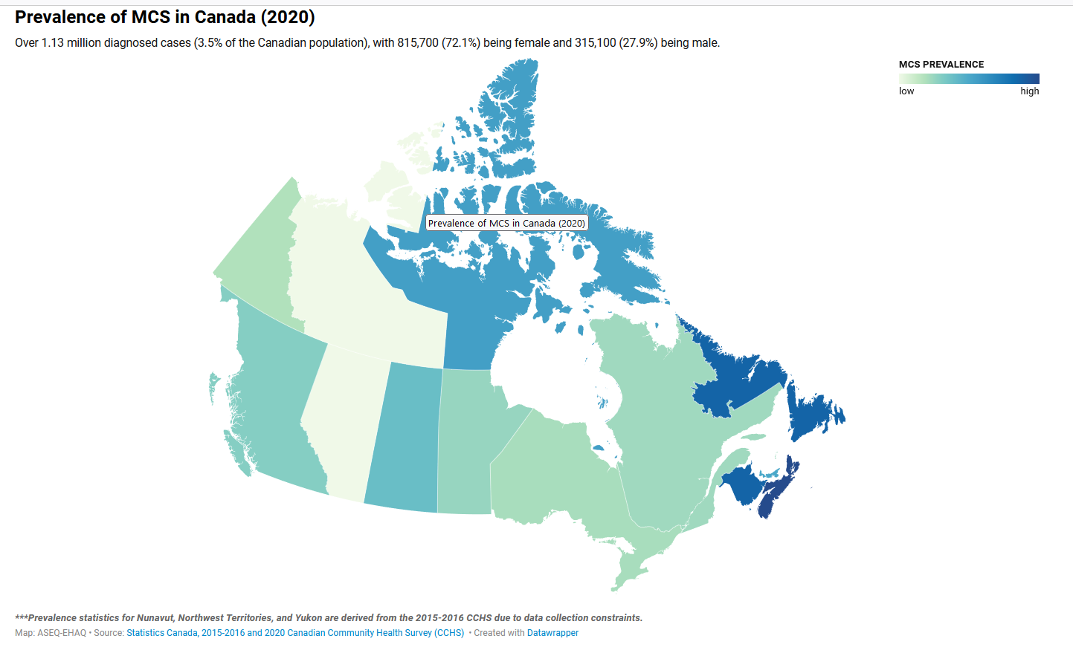
aseq-ehaq.ca

Slide 23
Key Metrics of ECRoB Project
Goals | Completed until October 2024
Educational tools | 255 and ongoing
95 workshops | 108
2,000 people reached through workshops | Over 5,400 people reached - workshops
6,000 surveys | 6,351 surveys
2,000 polls | 23,671 polls
Website visitors – 1 million | 947,902
8,000 calls | 8,036
10,000 emails | 12,900

Slide 24
Organizations reached out to across all provinces and territories
Type | Number contacted
Disability | 134
Education | 97
Environmental Groups | 66
Health Organizations | 156
Housing Groups | 98
Type | Number contacted
Legal Associations | 606
Press | 102
Senior Associations | 27
Labor Unions | 73
Women’s Groups | 51

Slide 25
Total Workshops Delivered: 104
Target Audiences | Details | Workshop Focus Areas
 | - Human Rights Commissions | Biological Aspects of MCS
 | - Law Societies | Social Impacts of MCS
 | - Government Agencies | Accommodations for Inclusion and Accessibility for MCS
 | - Professionals (including lawyers) | Legal Framework and Rights
 | - People with MCS and other disabilities
 | - Civil Society

Slide 26
Surveys
Category | Details
Survey Types | - Pre-workshop surveys
 | - Post-workshop surveys
 | - Surveys shared with individuals with MCS
Subjects Covered | - Impact of the INSPQ report in MCS in Québec, Canada & internationally
 | - Accessibility challenges in the workplace, healthcare, housing, and travel
 | - Impact of chemicals, such as scent boosters
 | - Lack of transparency in product labeling
 | - Lack of access to medical and emergency care
Key Insights | - Pre-workshop surveys showed a lack of information on MCS
 | - Post-workshop surveys indicated increased willingness to provide accommodations for MCS
Purpose | - Gather information on lived experiences of individuals with MCS
 | - Assess knowledge and attitudes before and after workshops

Slide 27
Focus Groups
Category | Details
Focus Group Goals | - Address misattribution, misconceptions, and misunderstandings of MCS
 | - Tackle barriers to understanding and support
 | - Promote fragrance-free and least-toxic spaces
 | - Prevent avoidance as the sole coping strategy
 | - Raise public awareness about MCS and its financial implications
 | - Address healthcare and institutional misconceptions
 | - Enhance research efforts
 | - Regulate commercial influences and misleading practices
Reports and Outputs | - Surveys and focus group findings submitted as policy recommendations to the Government of Canada
 | - Ethics approval secured by a partner for focus group studies
 | - Manuscripts in preparation for peer-reviewed journal publication to advance scientific understanding
Impact | - Contributed to policy advocacy and raised awareness through evidence-based insights

Slide 28




Educational Resources for Accessibility and Support
What We’ve Created:
Documents (116), Videos (90), and Reels (49):
Focused on accessibility in healthcare, legal aspects, and workplace accommodation.
Designed to educate the public and support individuals with MCS.
Where to Find Them:
Website: Comprehensive library of resources.
YouTube Channel: Informative videos and tutorials.
Social Media: Engaging Reels and posts for wider reach.

Slide 29
Social Media - July 2023 to July 2024
Category | Achievements
Overall Impressions | Over 17 million impressions across all social media platforms by July 2024.
Platform-specific Metrics | - Facebook: 10 million reach, over 37,000 interactions.
 | - TikTok & YouTube: Combined 1.24 million video views, reflecting strong visual engagement.
 | - All Platforms (Facebook, Instagram, TikTok, YouTube, LinkedIn, Twitter): 10.98 million impressions.
Key Initiatives | - Social Media Engagement Series: Combined education and entertainment to strengthen connections.
 | - Campaigns: Highlighted MCS Awareness Month and Earth Month with interactive content and events.
 | - International Days: Leveraged observances like Earth Day to address critical issues.
Impact | - Expanded reach and engagement across diverse audiences.
 | - Insights gained to refine future content and advertising strategies for sustained growth.

Slide 30
Survey & Poll Insights - Summary
Survey results indicate a positive trend in awareness and support for individuals with MCS:
Awareness of MCS grew from 34% in May 2024 to 37% by September 2024.
Adoption of fragrance-free practices increased, with willingness rising from 45% (April–July) to 47% (August–September 2024).
Reports of symptoms from fragrances rose from 34% in May to 37% in August 2024.
Connections to MCS improved slightly, with 42% knowing someone with MCS in June, rising to 44% by September.
Commitment to accessibility via fragrance-free policies increased from 54% in June to 56% in August 2024.
These findings reflect growing awareness, personal connections, and an increasing willingness to adopt inclusive practices for individuals with MCS.

Slide 31
Social Media Reach: Nov 2022 – Oct 2024
Total Reach: 17,232,881
Total Video Views: 1,371,980
Total Engagement (likes, shares, comments): 87,317

Slide 32

Our Sincere Thanks

Slide 33





THANK YOU!

Slide 34
MOTION: 2023 AGM Minutes
Be it resolved that the Minutes of CareNow Ontario Annual General Meeting of November 1st 2023 be approved with the following amendments:
Pg 1 item 2: be amended from "as present” to “as presented”
Pg 3 item 5.1 (2) add reference “with the assistance of consultant Bill Manson, formerly with the Toronto Central LHIN”
Pg 6. Add “Directors Report was a verbal report”. Delete “will be attached with the AGM minutes”.
Moved by: John Doherty
Seconded by: L.aurie Menard
Moved by: John Doherty
Seconded by: Keith Deviney
Notes:
Thank you Rohini. You are welcome to stay for the rest of the meeting if your time permits
Now we will move to the business of the meeting
The First order of business it to approve the minutes from the 2023 AGM.
The minutes were sent out in advance of the meeting and a member sent us some amendments that we have included in the motion.
Read the Motion:
Any discussion on the amendments or any other amendments.
I’ll call on Adrianna to conduct the vote.
Adrianna announces the results

Slide 35
Treasurer’s Report
Adrianna Tetley, Treasurer
Notes:
Keith: I’ll now call on Adrianna Tetley, Treasurer to provide the Treasurer’s report.

Slide 36
Financial Summary ending Dec 31 2023
4
Revenue:
Donations, Membership Fees, Interest $12,183
Expenses:
Professional fees, office expenses,
Personnel, insurance $ 9,310
Net (positive) $ 2,873
Assets Dec 2022 $ 4,292
Net Dec 2023 $ 7,166

Slide 37
Projected Year End - 2024
4
Net Assets Dec 2023 $ 7,166
Revenue $ 10,000
Expenses $ 9,000
Net Surplus 2024 $ 1,000
Projected Net Assets Dec 2024 $ 8,166

Slide 38
Looking Forward to 2025
4
Forecast:
Revenues: $10,000
Expenses: $ 9,000 (All expenses have been minimized)
Annual Surplus $1,000.

Slide 39
Sustainability for CareNow Ontario
4
With the annual fundraising campaign sent to our data base and reaching out to the Board’s network of friends and family
And the minimized expenses,
CareNow Ontario will continue to be sustainable into the future.
The $7,166 will be held in reserve to manage any unexpected expenses and to be prioritized for any advocacy work that we may need to undertake.
Notes:
With a minimum and conservative budget, under the financial management of the Board of Directors, we are optimistic that we can continue to be viable for the foreseeable future.
We will report our financial plan annually.
Once again thank the anonymous donor wo contributed $50,000 in 2015 – the majority of which was used to refresh MEAO and to take us to where we are today with MEAO.
Any questions or discussion?
We believe that we have now accomplished the refresh and used the funds for which they were intended.

Slide 40
MOTION: Financial Statements 2023
Be it resolved that the Financial Statements (notice to reader) of CareNow Ontario as reviewed by chartered accountant, Welch LLP and as presented for the year ended December 31, 2023 be approved.
Moved by: Adrianna Tetley
Seconded by: Keith Deviney
Notes:
Adrianna to read the motion
Adrianna to conduct the vote

Slide 41
MOTION: Auditors for 2024
Be it resolved that Welch LLP chartered accountants be appointed auditors for financial reviews and financial matters for CareNow Ontario for the year 2024 at the appropriate remuneration as determined by the Board of Directors
Moved by: Adrianna Tetley
Seconded by: Keith Deviney
Notes:
Adrianna
Adrianna to conduct the vote
Back to Keith

Slide 42
Nominations Report
John Doherty, Secretary
Notes:
Keith calls on John Doherty, Secretary to present the Nominations report
John presents Nomination’s report

Slide 43
Election of Directors
Phil DeGroot is standing for election as a Director for CareNow Ontario for a three-year term.
Phil to say a few words of introduction.
ELECTION by roll call vote
Notes:
John calls for a vote to elect Phil de Groot for a three year term.
Calls on Phil to say a few words….
Adrianna calls the roll call for the vote

Slide 44
CareNow Ontario Board of Directors – 2024-25
Phil DeGroot
Keith Deviney
John Doherty
Laurie Menard
Adrianna Tetley
Notes:
John presents the Board for 2024-25

Slide 45
Update on Government Relations & Advocacy
A. Tetley
Notes:
Keith calls on Adrianna to provide an update on government relations & Advocacy,

Slide 46
1. Action Plan on Task Force Report on Environmental Health
Despite regular and ongoing advocacy to Minister’s office and the Ministry of Health there has been no response to the overall progress of the Task Force Report.
. We stay firm on our core asks to the Government and will reinitiate them immediately after the next election and the appointment of a new Minister of Health.
Notes:
.

Slide 47
Calls to Action to Government of Ontario
To implement and fund the recommendations in the Business case for a Centre of Excellence in Toronto, regional MCS safe clinics and local, specifically trained primary care, submitted in 2013.
To immediately release Laying the Groundwork, an action plan developed by Dr. Brian Schwartz, former Vice President, Public Health Ontario, and submitted to the Minister of Health in July 2021.
To immediately fund the development of case definitions and clinical guidelines for best practices and clinical pathways; fund development of clinical curriculum and require Ontario universities to incorporate this curriculum along with research projects into medical schools and public health schools.
Notes:
.
Just as a reminder, this remains are three core asks.

Slide 48
Action Plan Release: Freedom of Information Request
The NDP submitted a FOI request in 2022.
CareNow Ontario received a redacted report that only left the table of contents and the name of the people consulted.
The NDP has gone through three levels of appeal with no success.
The NDP has run out of options to appeal so this process has now been deemed closed unsuccessfully.

Slide 49
Action Plan on Task Force Report on Environmental Health
Possible Next Steps:
Meet with the NDP, Green Party and the Liberals prior to the election to see if we can get their support.
Election is expected in spring 2025.

Slide 50
2. CEP Primary Care Tool
Each year CEP is funded by the Ministry of Health to develop tools for primary care physicians. This work is funded through the Primary Care branch.
CareNow Ontario is not clear on who in the Ministry of Health advocated that the CEP Tool for ME, FM, POTs and MCS be on the list for development in 2023-24.
Not clear if this tool was a result of the ‘unreleased’ implementation plan.
Currently no evidence of other work being done
CareNow Ontario has been clear with Ministry of Health and CEP, that while we cautiously support the development of thse tools, it is by NO MEANS sufficient to meet the vision of the Business case for the Centre of Excellence.

Slide 51
2. CEP Primary Care Tool
Denise Magi, on behalf of CareNow Ontario was a member of the Topic Expert Group (TEG) and spent many hours on the development of these tools.
In late summer, 2024, three tools were released: FM, ME/CFS and POTS and posted on the CEP website. These tools will be very helpful for physicians and nurse practitioners with patients with these conditions.
As of today, the tools have been downloaded 3515 times
At the same time, one very damaging and misleading paragraph was put on the CEP website re MCS
..

Slide 52
2. CEP Primary Care Tool
.
On May 15 Awareness Day, CareNow Ontario held a webinar to share the positive news of the three developed tools and to present the problems with the one MCS paragraph.
CareNow Ontario immediately sent a letter to the Minister of Health and requested that this paragraph be removed.
France Gelinas, NDP supported our request and met with the Minister on our behalf.
Two weeks later the damaging paragraph was removed.
..
Notes:
Adrianna to call on Denise to add her perspectives and thoughts on the CEP tool

Slide 53
2. Primary Care Tool for MCS – Sessional Paper Q 222 by F. Gelinas – May 2024
.
In May 2024, MPP France Gelinas followed up with a Sessional Paper Q 222 to the Minister
Would the Minister of Health please indicate when her Ministry will develop a multiple chemical sensitivity (MCS) tool for family physicians that is equivalent to fibromyalgia, myalgic encephalomyelitis/chronic fatigue syndrome and Postural Orthostatic Tachycardia Syndrome that reflects the evidence and protocols that MCS is a multi-system, biophysical, toxicological condition impacted by exposure to chemicals. (Sessional Paper No. 222) (Tabled by MPP Gélinas, France (Nickel Belt), 05/27/2024)
..

Slide 54
2. Primary Care Tool for MCS – Sessional Paper Q 222 by F. Gelinas – May 2024
.
Response by Minister: Nov 21, 2024
First states that people with MCS can receive services from interprofessional pc teams across Ontario – and that they announced an increased investment of $110M in 2024
“Ontario Health’s Quality Standards are voluntary tools for health care practitioners and outline what high-quality care looks like for conditions and processes where there are large variations in how care is delivered, or where there are gaps between the care provided in Ontario and the care patients should receive.
While there is no Quality Standard for MCS, there may be Quality Standards that address symptoms related to MCS (e.g., asthma).”
Then provides information on how to request such as standard be developed
..
Notes:
Adrianna to call on Denise to add her perspectives and thoughts on the CEP tool

Slide 55
3.2 Attack on MCS: The Binkley article
In September 2023, Dr Farah Tabassum alerted us to an article written by Dr Binkley that was released on-line in the journal of Allergy Clinical Immunology Practice
The hard copy of the article was published in November 2023.
The article takes a psychological approach to the causation of MCS.
Dr Binkley is an associate professor, dept of medicine, Division of Clinical Immunology and Allergy; and staff at St Michaels and Sunnybrook
Binkley KE. Multiple chemical sensitivity/idiopathic environmental intolerance: A practical approach to diagnosis and management. J Allergy Clin Immunol Pract. Forthcoming 2023; S2213-2198(23)00961-3. https://doi.org/10.1016/j.jaip.2023.08.039
Response: Letters to the Editors (limit 500 words)
Psychological approach is dangerous to patients
Did not sue recent research
Outlined the biophysical toxicological school of thought.
The Environmental Health Centre physicians lead by John Molot
CareNow Ontario and Ontario Environmental Health Advocates: big thanks to Varda and Maureen
ASEQ and their national organization.

Slide 56
Attack on MCS: The Binkley article
Letters to the Editors (limit 500 words) submitted
Psychological approach is dangerous to patients
Did not use recent research
Outlined the biophysical toxicological school of thought.
By:
The Environmental Health Centre physicians lead by John Molot
CareNow Ontario and Ontario Environmental Health Advocates: big thanks to Varda and Maureen
ASEQ and their national organization.
These letters were published in February 2024 in the Journal of Allergy and Clinical Immunology.

Slide 57
Advocacy Workplan for 2025
Notes:
Adrianna to just continue

Slide 58
1. Advocacy for a Centre of Excellence
Prior to the Election: Meet with the NDP, Green Party and the Liberals to gain their support for the release of the Implementation Report and the funding to implement the recommendations..
After the Election, meet with the new Minister of Health

Slide 59
2. Primary Care Tools
Follow-up re: the letter sent to the Minister of Health requesting:
that the Ministry of Health fund CEP to develop a tool for MCS using approved experts and the same process as was used for the other three tools.
That the MOH fund a process to develop clinical guidelines for MCS
Follow-up with Centre for Effective Practice re implementing a distribution strategy so that more physicians and nurse practitioners become aware of the tools for FM, ME/CFS and POTs
Follow-up with Ontario Health re developing a Quality Standard re MCS.

Slide 60
2. Hospitals as safe spaces for people with ES/MCS & EHS
Step 1:
Varda Burstyn is in the final stages of developing a kit for patients with ES/MCS & EHS to advocate for a care plan when they go to their local hospitals.
This kit includes a step-by-step guide, sample accommodation agreements that you can share with your hospitals, sample letters you need to get from your physicians and so on
This tool kit will be uploaded to the CareNow Ontario website once it is completed
CareNow Ontario will hold a webinar with members and friends to walk through the kit and show you how to use it with your physicians and hospitals.

Slide 61
2. Hospitals as safe spaces for people with MCS
Step 2:
CareNow Ontario will advocate with the Ontario Hospital Association that all Hospitals adopt these policies and procedures.
Stay tuned for more information on the webinar to be hosted early in 2025

Slide 62
Denise Magi’s Reflections
Comments by the outgoing president and chair
Notes:
Keith
After

Slide 63
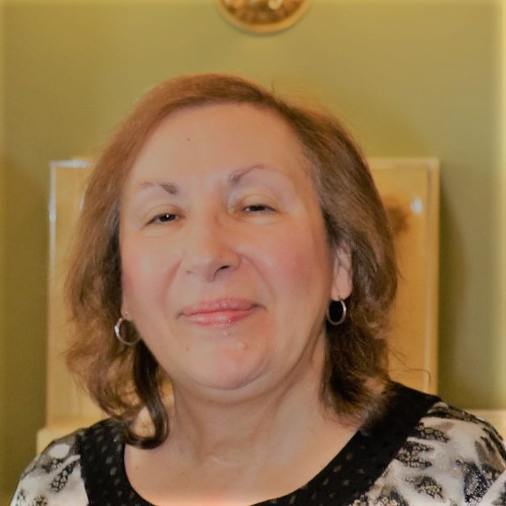
Tribute to
Denise Magi
Notes:
Keith –
Denise has dedicated her life to fighting for a system of care for people with ME/CFS, FM and ES/MCS & EHS – She made it clear that MEAO and now CareNow Ontario represented people with all three conditions.
Over her sixteen years Denise has been secretary and president for MEAO and now CareNow Ontario
Throughout this time, she held the organization together. She wasthe person who managed ALL the operational details with very strong due diligence, ensuring bills were paid and that we were compliant on all legislative matters.
While her accomplishments are many, I want to highlight a few including
representing MEAO on the Steering Committee to develop a business case for Environmental Health
Representing MEAO on the Taskforce on Environmental Health – including all subcommittees
Ensuring persistence in getting Brian Schwartz Vice President Public Health Ontario appointed to develop an implementation plan for the Taskforce report.
Then – when Covid hit - getting Bill Manson hired to support Brian so that the work on the Implementation Plan continued
Denise was unwavering in getting both the interim and final report of the Taskforce released and continues to her last days with us to try and get the implementation plan released.
Last year, despite her personal challenges, Denise represented CareNow Ontario on the Topic Expert Group that saw the comletion of three tools for FM, ME/CFS and POTs and continues to advocate for an equivalent tool MCS.
Denise was well known to all Ministers of Health during her tenure (except the current one -which everyone is struggling with) and built strong relatiionships with the health critics of all parties, and staff at all levels.
Denise, Before we say more on behalf of CareNow Ontariio, there are a few of your friends who want to share a few words.

Slide 64
France Gelinas, NDP Health Critic
https://1drv.ms/u/c/7e8393c12d8988f3/EVtEYuLse7xIr-l9bf1thiQBY6TyeZRg-OOSe4UpFVnygA?e=ZUKJJ1
Notes:
France Gelinas is the NDP Health Critic and as you heard earlier in our meeting, is a long time, consistent and strong advocate for the work of CareNow Ontario
France was not available in person (as she is enjoying a conference in Paris ☺), so she sent us her remarks via video
Let’s give Adrianna a few seconds to bring up this video.

Slide 65
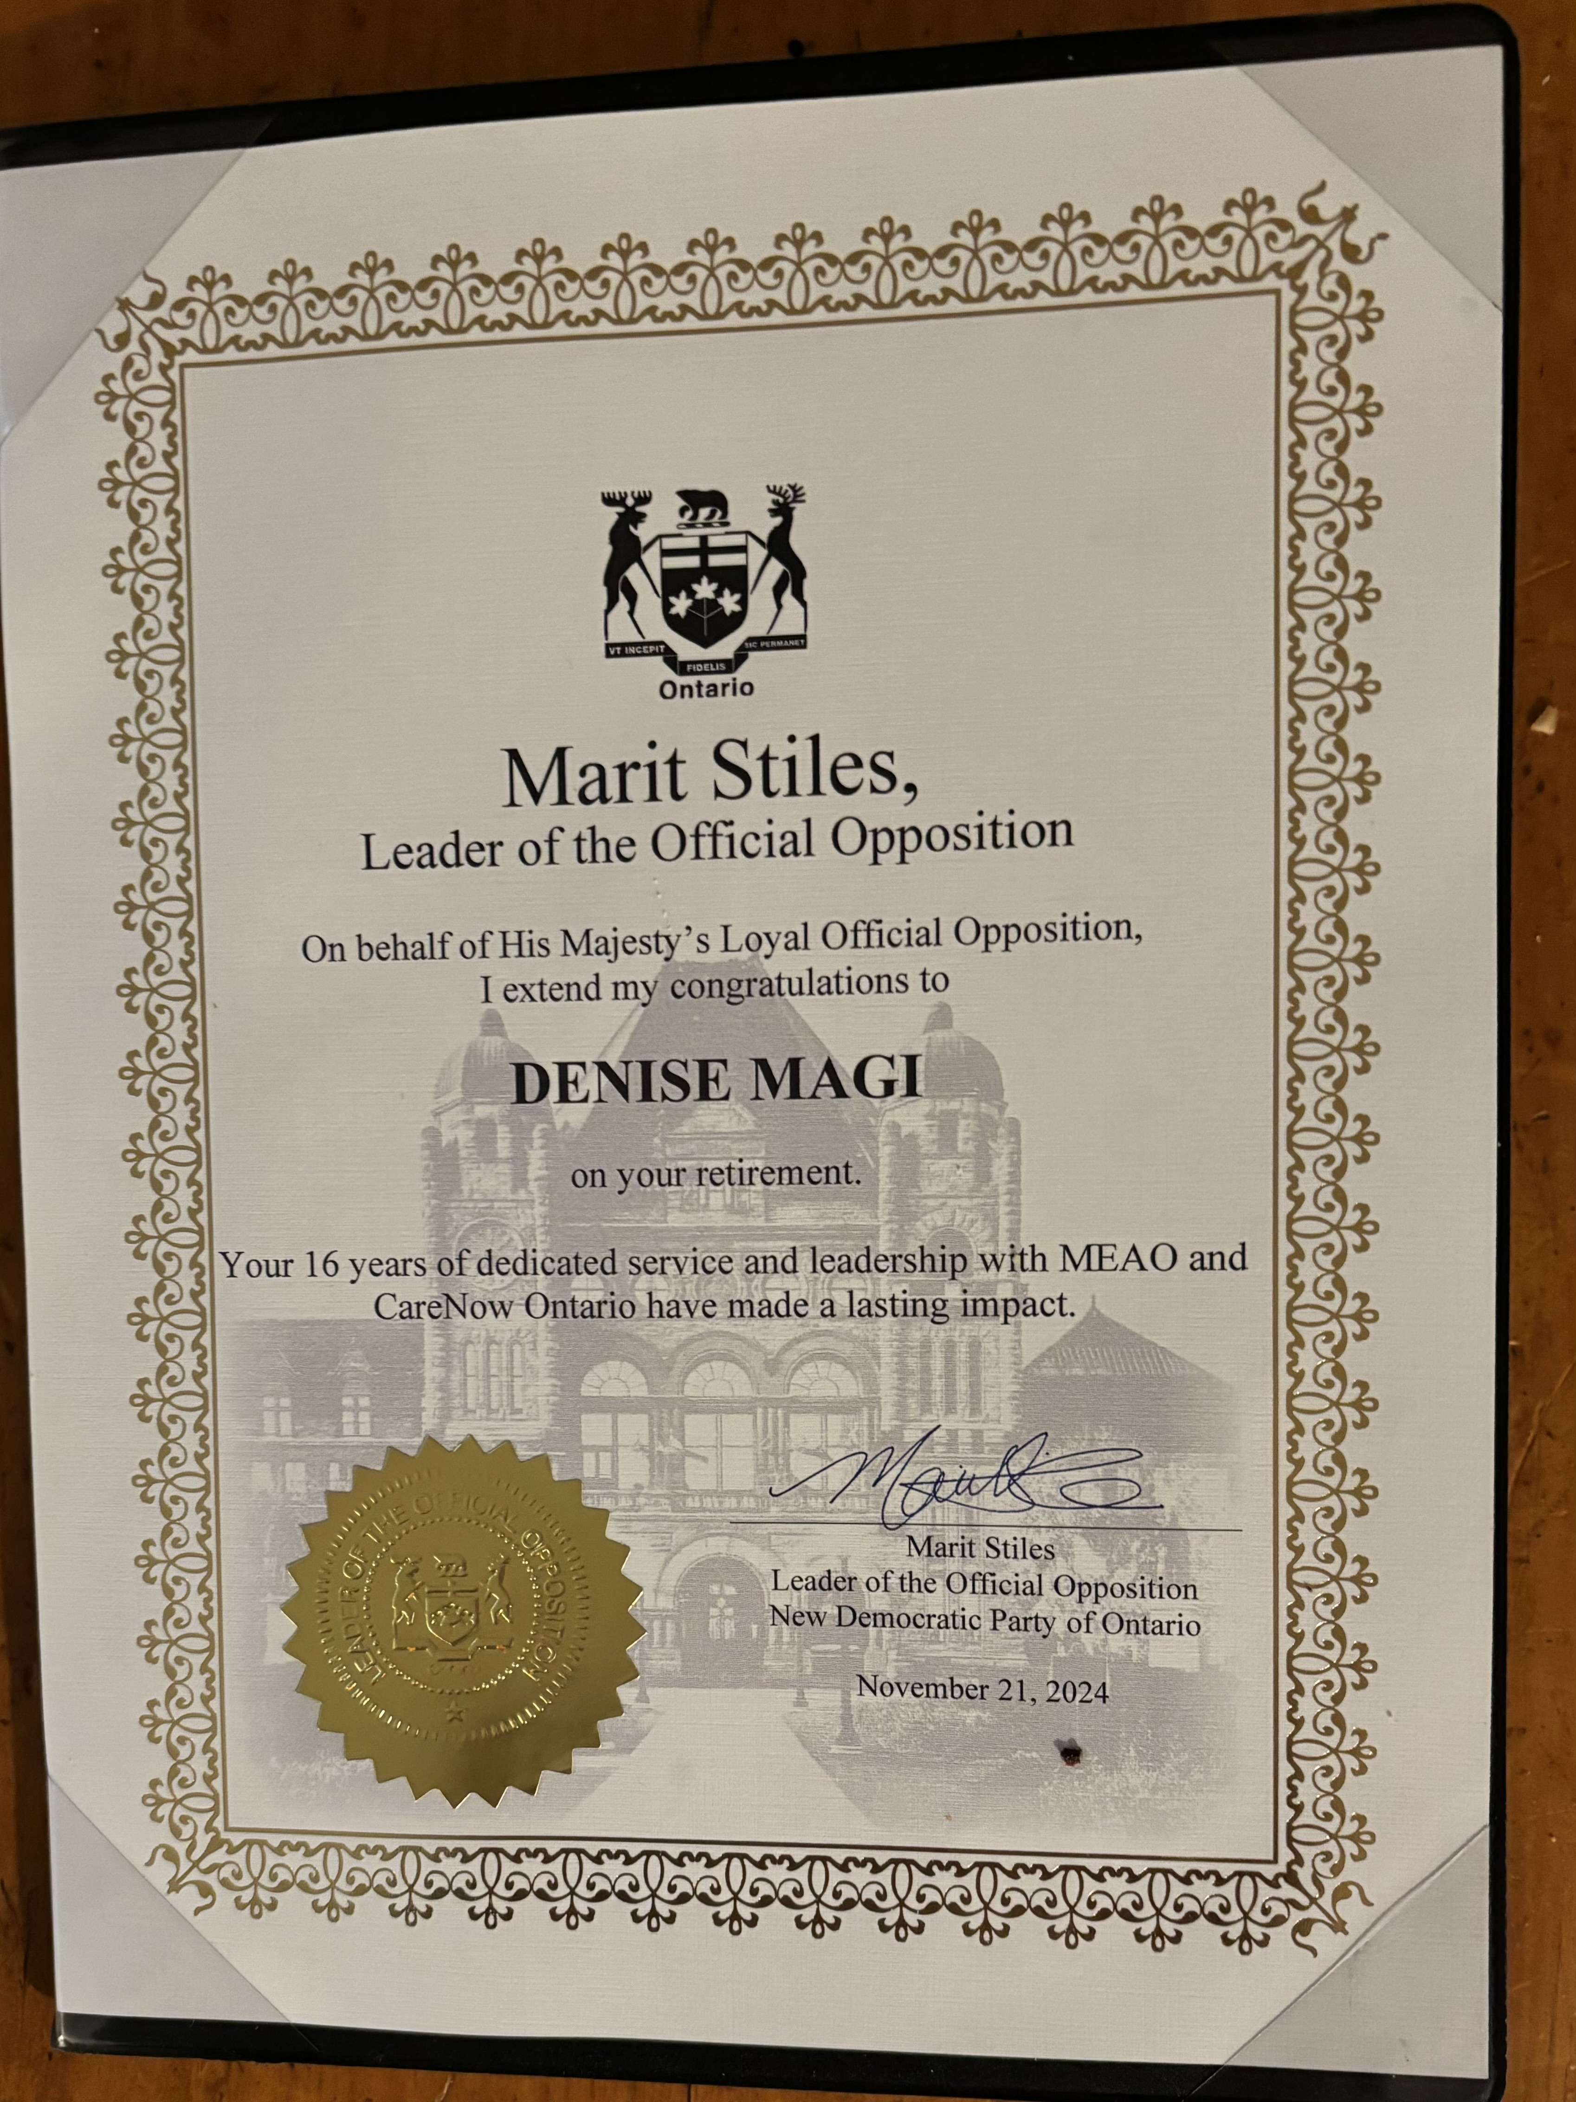
f
Marit Stiles
Leader of the NDP
Notes:
Thanks to France for her kind remarks
In addition, Marit Stiles, leader of the official opposition and leader of the NDP sent this certificate. That states
“on behalf of the official opposition, I extend my congratulations to Denise Magi on your retirement Your 16 years of dedicated service and leadership with MEAO and CareNow Ontario have made a lasting impact.”

Slide 66
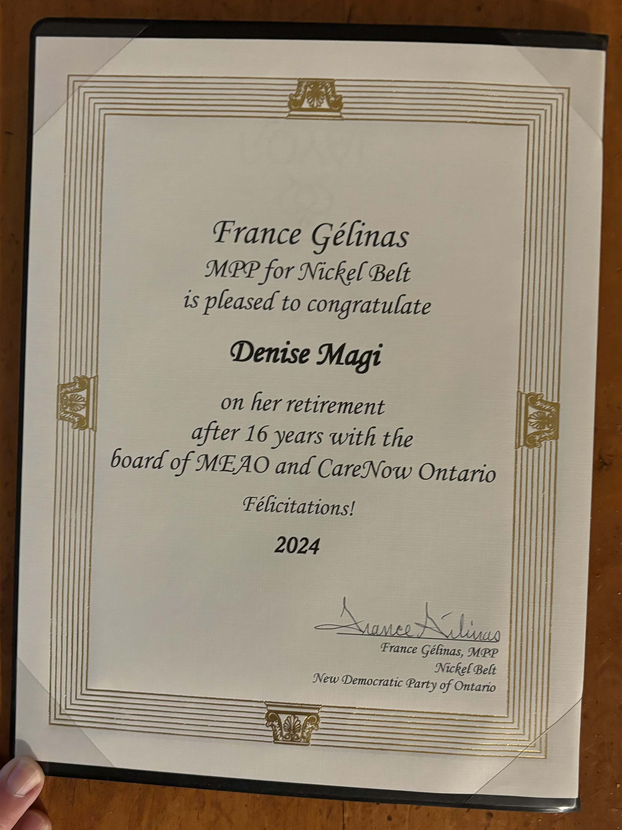
France Gelinas
MPP Nickle Belt
NDP Health Critic
Notes:
In addition France Gelinas sent this Certificate.
France Gelinas, MPP for NickleBelt is pleased to congratulate Denise Magi on her retirement after 16 years with the board of MEAO and CareNow Ontario.
Felicitations!
Adrianna has the originals in a lovely black folder and will forward to Denise after this Tribute. (Adrianna to hold up the folder on the screen)

Slide 67
Bill Manson
Denise – my wonderful friend and colleague! You are an incredible human being who has always put everybody and everything you believe in first, no matter what your personal health challenges. Your ability to pursue a goal with passion and stick with it even if you encounter obstacles or setbacks is truly a gift. You are a role model, and we all owe you so much for keeping up the good fight. You are always there with a friendly hello. Best wishes my friend, keep in touch!
Denise – my wonderful friend and colleague!
You are an incredible human being who has always put everybody and everything you believe in first, no matter what your personal health challenges.
Your ability to pursue a goal with passion and stick with it even if you encounter obstacles or setbacks is truly a gift.
You are a role model, and we all owe you so much for keeping up the good fight. You are always there with a friendly hello.
Best wishes my friend, keep in touch!
Notes:
Bill Manson is known to many of us. He was originally involved with MEAO and CarNow Ontario as the staff person responsible fo the Environmental Health Clinic when he was with the Toronto Central LHIN As a result of this role, Bill was a member of the Taskforce for Environmental Health. He resigned before it was completed due to is workload at the TC LHIN
A few years later, when Bill had recently retired from the TC LHIN we convinced him to take on a contract with Public Health Ontario to work with Brian Schwartz to develop the implementation plan for the Minister of Health this report was never released but I know many of you had conversations with Bill when he was doing this work
Bill was also not available in person but he wanted us to share these words.

Slide 68
Dr. John Molot
Environmental Health Clinic
With focus on MCS
Notes:
Dr John Molot really needs no introduction to most of you in attendance as he and his work are well known
He has worked with Denise over the entire last 16 years (and probably beyond) and he wanted this opportunity to share a few words about Denise as well
Over to you John

Slide 69
Dr. Farah Tabassum
Please accept my heartfelt congratulations to you on your retirement from your role as President and Chair of CareNow Ontario.
I want to express my sincere appreciation and gratitude for your years of dedication, passion, and tireless advocacy for those in our communities affected by ME/CFS, fibromyalgia, and multiple chemical sensitivity.
I am very grateful to have had the opportunity to have worked so closely with you on the very important educational initiative that we were both a part of over the last year. Your wisdom, compassion, and leadership were invaluable and have without a doubt assisted with the advancement of care for patients with these conditions.
Though you may be stepping down from the board, your legacy of perseverance and embracing all wins for the community, no matter how big or small, will continue to inspire others as they continue on with this important work.
With deep respect and appreciation, I want to say thank you for all of your contributions and I wish you all the very best in this next chapter of your life.
Notes:
Dr Farah Tabassum, is a more recent family physician at the Environmental Health Clinic. Her speciality area is ME/MCS.
In addition to working closely with Denise over the last few years, Farah has always said yes when CareNow Ontario needed information. She also was the key author the ME/CFS section on our website along with Maureen MacQuarrie.
Most recently, Dr Farah Tabassum was the clinical lead on the CEP project for the development of the tools related to FM, ME/CFS, and POTs and along with John advocated for a tool re MCS.
Farah was also not available but she wanted us to share these remarks.

Slide 70
Izzat Jiwani
I have worked with Denise for many years on the previous MEAO and the current CareNow Ontario.
Denise, thank you for your dedication and perseverance on advocating for improving services and care for those with ME, FM and MCS.
As a lived experience and part of MEAO/CareNow organization, I and most members are aware of the very challenging environment that this work involved and continues to involve.
I
would like to thank you for your many years of work on these complex health conditions despite your own personal health issues.
With you the best for your health and well being.
Notes:
Izzat is an active member of MEAO and now CareNow Ontario
Denise and Izzat go back throughout all her years with MEAO and now CareNow Ontario.
In the earlier years, Izzat was on the Board of MEAO. And was a member of the Taskforce for Environmental Health with Denise as a person with lived experience.
Izzat was also not available but requested that we read her well wishes.

Slide 71
Erika Halapy
Notes:
Not sure when Erika first met Denise, but we do know that Erika did the research and epidemiological study to support the Business Case for Environmental Health and remains an active member of MEAO and CareNow Ontario over the years
Erika is with us today and is pleased to say a few words.
Over to you Erika

Slide 72
Diane Meitz
A heartfelt thank you for all your dedication and hard work for those with the debilitating illnesses MEAO ... of course now Care Now Ontario helps with.
I know you have put the association/charity first before your own health many times.
It is my wish you have that restful and healing time we all need at times. Sending you a big hug!. My kitties and I wish you a meowy Christmas!
All the best sweetie!💕
Notes:
Diane also wanted to attend – but has a family matter to take care of
She also asked that we read a few words –
even if she was here in person, someone would have to read it as she said she would shed too many tears in gratitude for Denise
Here are her words.

Slide 73
Keith Deviney
Notes:
Keith
Now is my turn to say a few words on a personal level and as a co director with Denise on both the boards of MEAO and CareNow Ontario.
KEITH – your remarks.

Slide 74
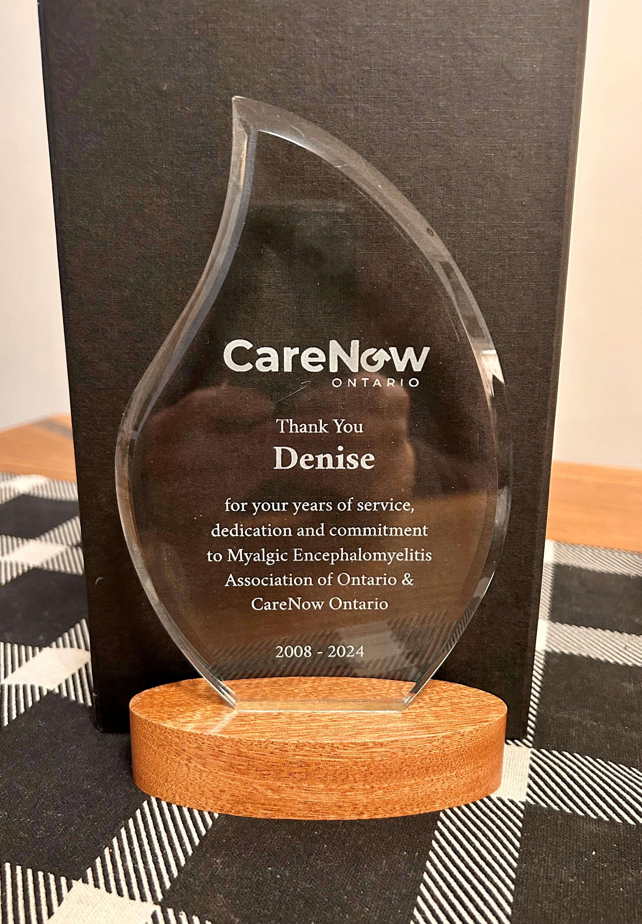
On Behalf of the
CareNow Ontario
Members &
Board of Directors
Notes:
So Denise
I hope you hear these words of gratitude and appreciation from your friends and colleagues
At this time CareNow Ontario would also like to take the opportunity to express our gratitude
by presenting to you this small token of our appreciation so that it can sit on your desk and remind you how much we respect you – how much we are grateful to you and How much we will miss you.
The award reads “ Thank You Denise Magi for your years of service dedication and commitment to MEAO and CareNow Ontario 2018-2024
Finally - we are not saying good bye - We respect your input and support and want you to stay engaged at the level that you are able. With this in mind, the Board of Directors is honouring you with the title of Honourary Past President. This is a role with out any pressure – no voting rights – just a seat at the table when you are able to participate.
We look forward to your continued engagement, your wisdom and your guidance.
Thank you again Denise and if you want to say a few words, the floor is yo

Slide 75
Other Business
Notes:
Keith
Any other business?
Seeing now, lets move to adjourn.

Slide 76

Motion to Adjourn
Notes:
Keith
Moved by Adrianna to adjourn.
Seconded by Laurie Menard.
Meeting is adjourned.

